Slide 1
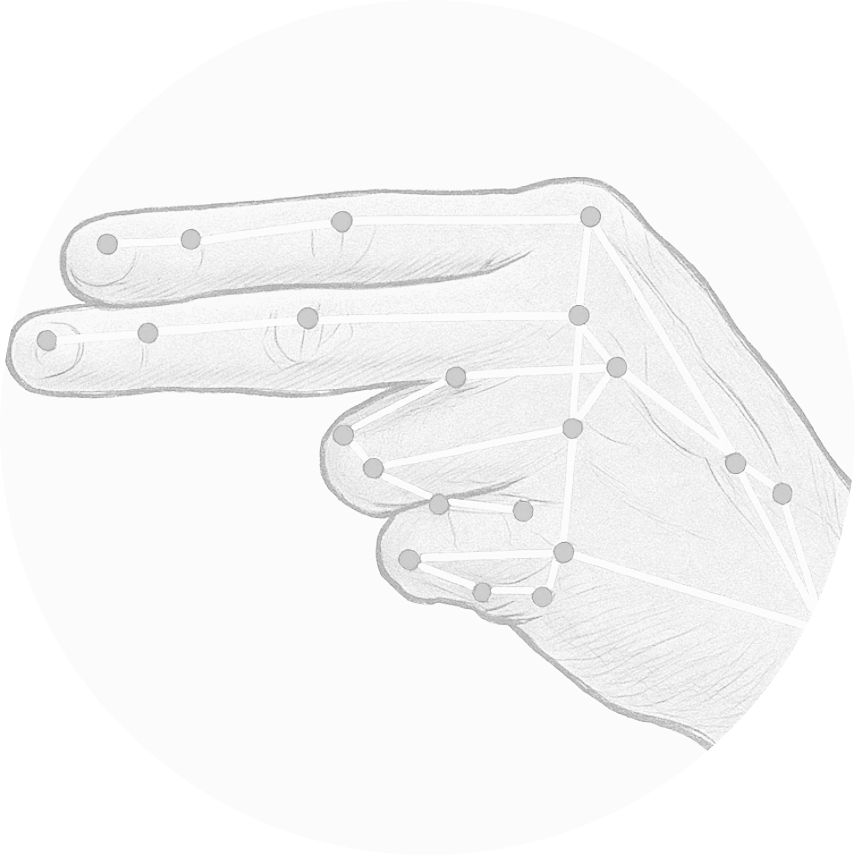
Arabic Sign Language Recognition System

Slide 2
Computer Science & Engineering dpt.
By
Abdalrhman Magdy Abdalaziz
Islam Ehab Mohamed
Islam Abd-Albaseer Abd-Alazeem
Waleed Mohamed Rehan
Supervisor
Dr. / Ahmed El-Mahlawy
Head of the Department
Prof. Dr. / Mohamed Berbar
Dean
Prof. Dr. / Ayman Elsayed

Slide 3

Content
Introduction
Background
Problem Statement
Previous Work
Theoretical Foundations
MediaPipe Framework
Artificial Neural Networks
Dart & Flutter

Slide 4
Content
Proposed Model
Data Preprocessing
Model Training
System & Evaluation Metrics
System
Model Evaluation
Deployment
Conclusion
Future Work

Slide 5
Introduction
Background
Problem Statement

Slide 6
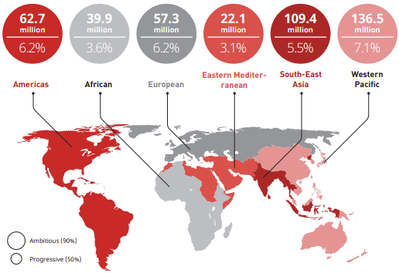
Background
Millions of people across the globe face daily challenges due to hearing impairments
WHO: 430 million people suffer from disabling hearing loss.
Egypt’s national household survey reported a 16.0% prevalence of hearing loss across all age groups with 22.4% in children aged 0-4 years

Slide 7
Background
That shows the critical need for inclusive technologies and assistive tools like Arabic Sign Language recognition systems to enhance communication, education, and social participation for deaf individuals especially for children in the Arab world.

Slide 8
Problem Statement
There is a communication gap between the deaf community and the general population.
Lack of accessible, real-time, and accurate ArSL recognition systems.

Slide 9
Key Challenges
Limited ArSL datasets.
High variability in gestures.
Real-time performance on low-end devices.

Slide 10
Previous Work
CNN-Based Approach
Transformer-Based Approach
Hybrid CNN-RNN Approach
Lightweight Mobile Models

Slide 11
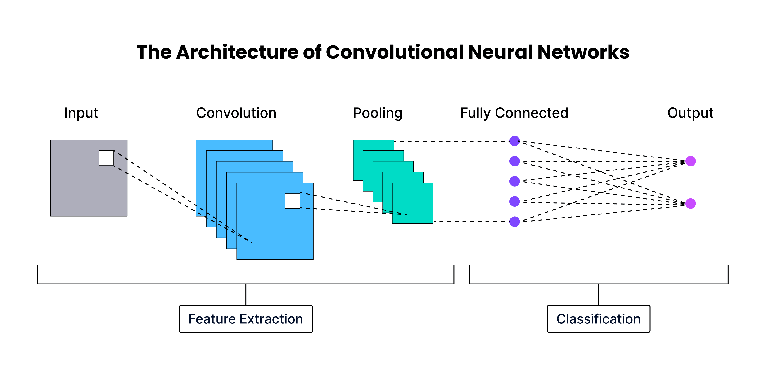
CNN-Based

Slide 12
CNN-Based
Developed by Dabwan Basel & Jadhav Mukti
Dataset consisted of 16,192 images
Yemeni Sign Language alphabets
Model accuracy of 94%

Slide 13
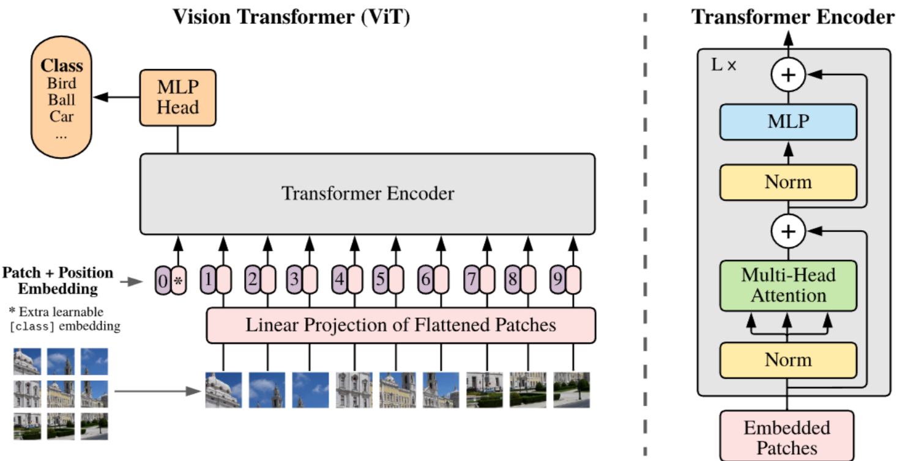
Vision Transformer (ViT)

Slide 14
Vision Transformer (ViT)
By Mazen Balat, Rewaa Awaad, Hend Adel, Ahmed B. Zaky, and Salah A. Aly
Transfer learning and transformer-based models.
CNN architectures like ResNet50, MobileNetV2, and EfficientNetB7
Dataset ArSL2018 consist of 54,049 grayscale images
results with 99.6% test accuracy o

Slide 15
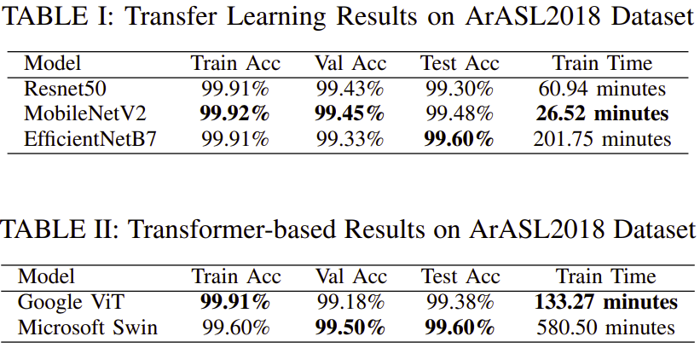
Vision Transformers (ViT)

Slide 16
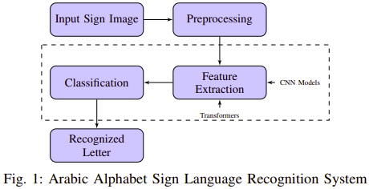
Vision Transformers (ViT)

Slide 17
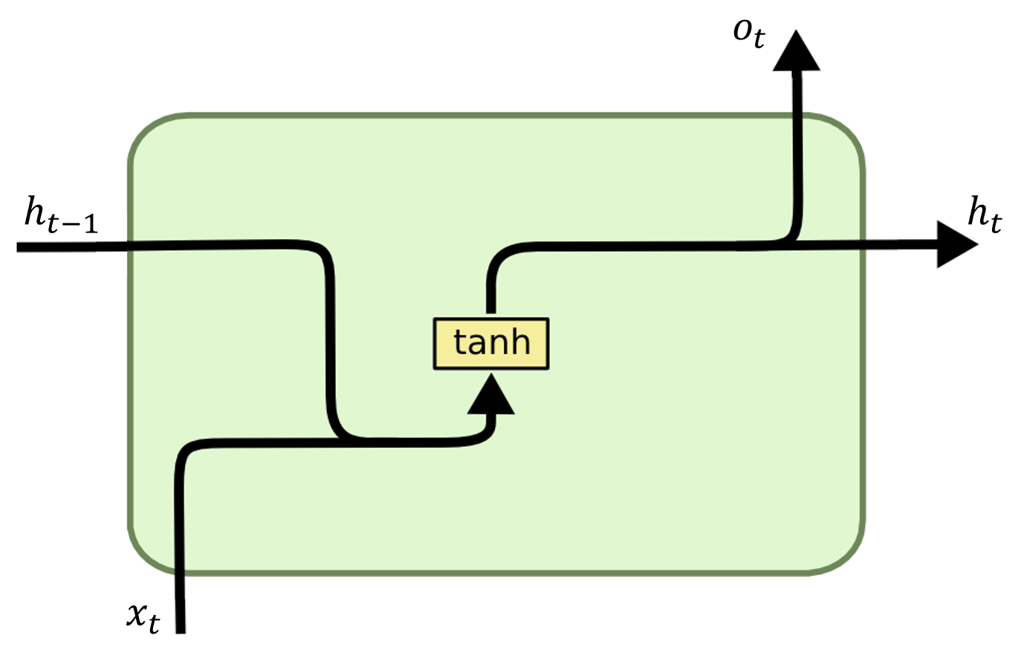
Hybrid CNN-RNN

Slide 18
Hybrid CNN-RNN
Research by Basel Dabwan and Mukti Jadhav
KArSL dataset has a total of 672 videos 24 for each class
30 FPS 1920x1080 pixels
Effectively capture both spatial and temporal features
Two hybrid models: ConvLSTM and Long-term Recurrent Convolutional Networks (LRCN)
ConvLSTM Validation accuracy of 95%
LRCN 93.33% validation accuracy

Slide 19
Light Mobile Models
By Batool Yahya AlKhuraym, Mohamed Maher Ben Ismail, and Ouiem Bchir
Dataset 5,400 images.
Using EfficientNet-Lite achieved 94.3% accuracy.
All models show some degree of overfitting, but Model 4 overfits significantly less than the others

Slide 20
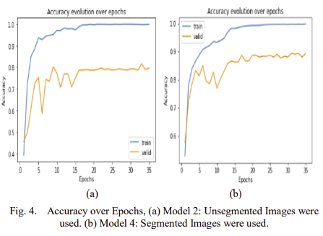
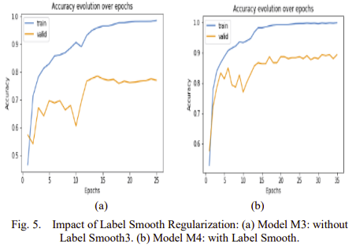
Light Mobile Models

Slide 21
Limitations of Existing Models
High resource requirements.
Overfitting.

Slide 22
Theoretical Foundations
MediaPipe Framework
Artificial Neural Networks
Dart & Flutter

Slide 23
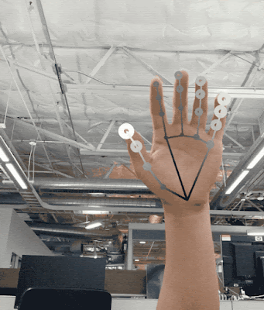
MediaPipe Framework
Extracts 21 hand landmarks in real time
Uses a model bundle:
palm detection model
hand landmarks detection model
The pipeline can run at 20–30 fps on mid-range phones

Slide 24
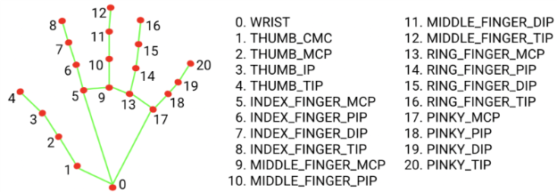
Key Points

Slide 25
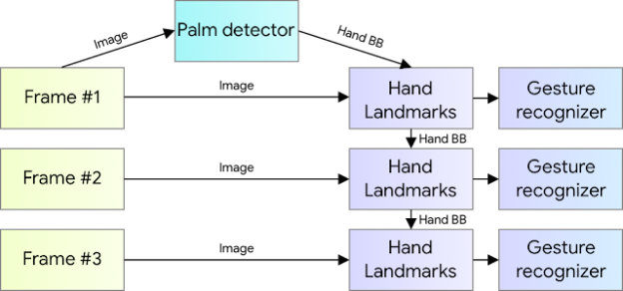
Hand perception pipeline overview

Slide 26
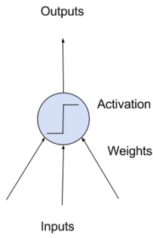
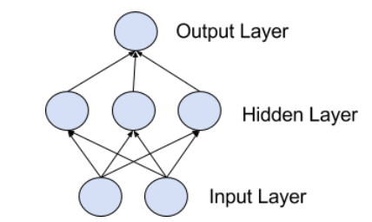
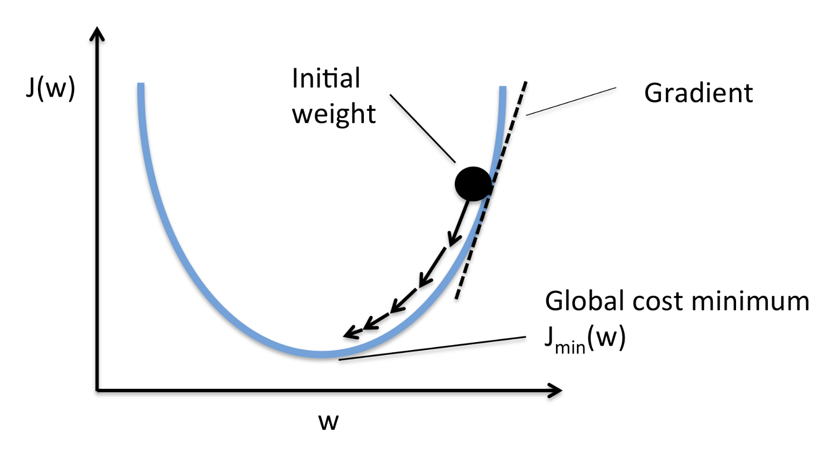
Artificial Neural Network
Neuron structure: input, weights, activation.
Layers: input, hidden, output.
Trained via forward , backpropagation, and SGD.

Slide 27

Flutter & Dart
The Flutter Framework is a popular, multiplatform UI toolkit that's powered by the Dart platform, and that provides tooling and UI libraries to build UI experiences that run on iOS, Android, macOS, Windows, Linux, and the web

Slide 29
Proposed Model
Overview
Data Preprocessing
Landmark Extraction & Normalization
Model Architecture
Training Process
Model Deployment

Slide 30
Overview
Input Frame
MediaPipe Landmark Extraction
Landmark Normalization
Feature Vector
ANN Classifier
Predicted Arabic Letter
System leverages MediaPipe for 3D hand landmark extraction (21 points per hand)
42-dimensional feature vector processed by TensorFlow neural network
Complete pipeline runs on-device without internet connection

Slide 31
Data Preprocessing
MediaPipe extracts 21 landmarks per hand
Normalize coordinates relative to the wrist
Flatten into 42-D input Vector
# Initialize MediaPipe Hands
mp_hands = mp.solutions.hands
hands = mp_hands.Hands(static_image_mode=False, max_num_hands=1, min_detection_confidence=0.5)
mp_draw = mp.solutions.drawing_utils

Slide 32
Data Preprocessing
# Function to extract landmarks (only x and y) from an image
def extract_landmarks(image_path):
image = cv2.imread(image_path)
if image is None:
print(f"Warning: Unable to read image {image_path}")
return None
image_rgb = cv2.cvtColor(image, cv2.COLOR_BGR2RGB)
results = hands.process(image_rgb)

Slide 33
Data Preprocessing
if results.multi_hand_landmarks:
for hand_landmarks in results.multi_hand_landmarks:
landmarks = [(lm.x, lm.y) for lm in hand_landmarks.landmark]
# Ensure exactly 21 landmarks are extracted
if len(landmarks) == 21:
return normalize_landmarks(landmarks)
return None # No hands detected

Slide 34
Data Preprocessing
def preprocess_landmarks(landmarks):
base_x, base_y = landmarks[0]
return [(x - base_x, y - base_y) for x, y in landmarks]
if len(landmarks) == 21:
normalized = preprocess_landmarks(landmarks)
input_data = np.array([coord for point in normalized for coord in point], dtype=np.float32)
input_data = np.expand_dims(input_data, axis=0)

Slide 35
Model Architecture

